Slide 1
Clean Project Code
Simplified project

Slide 2
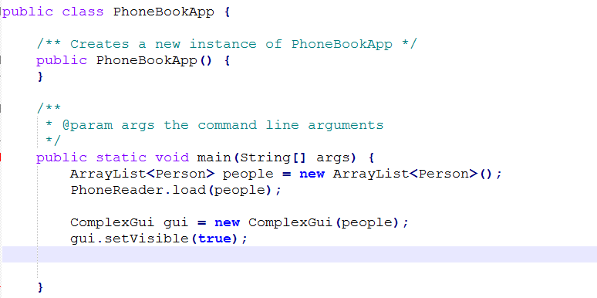
App class

Slide 3
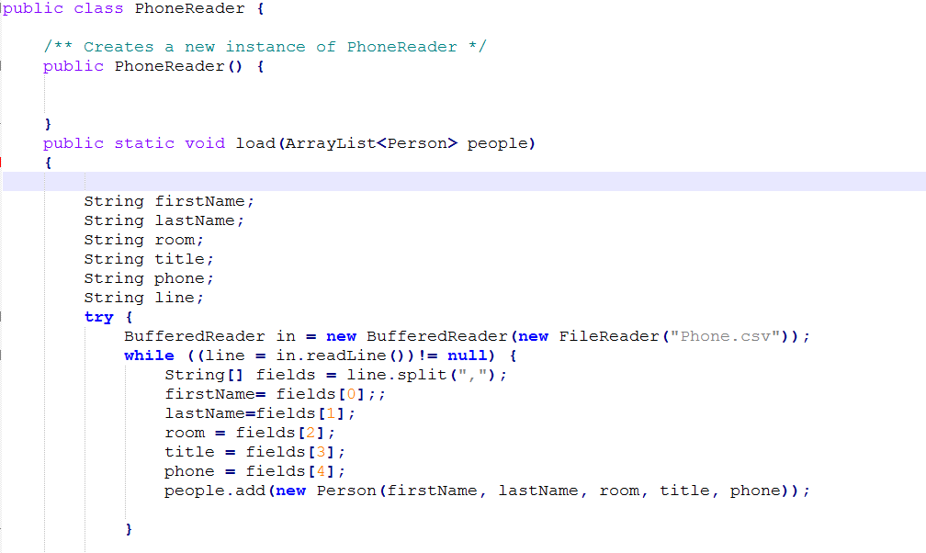
BaseReader class

Slide 4
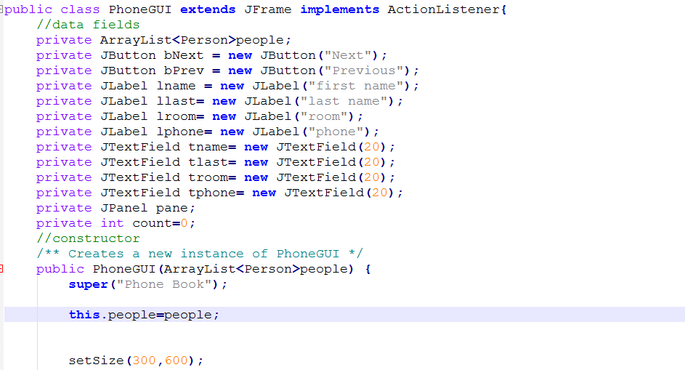
Gui class

